Slide 1





Top layer/text
Aug 25, 2023
Episode Details
User Spotlight! NetFoundry?!?!
tv ‘noise’

Slide 2

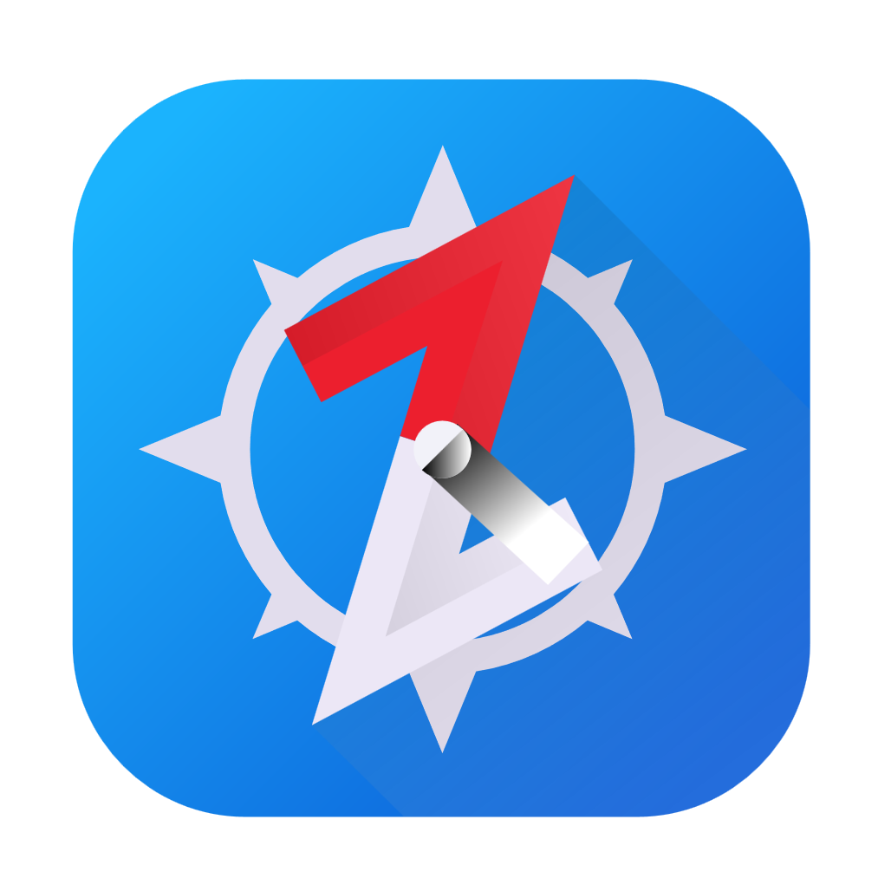
Aug 18, 2023
Episode Details
Let’s self-host BrowZer! (again)

Slide 3


Aug 4, 2023
Episode Details
zrok public beta!!!

Slide 4


Jul 21, 2023
Episode Details
Study Time
OpenZiti Overview!

Slide 5
What is Zero Trust
WHY Zero Trust
Anatomy of the overlay
Controller
Router
Tunnelers/clients/SDK
What’s a/an:
Service
Config
Service Policy
Identity
Study Time

Slide 6

Jul 14, 2023
Episode Details
User Spotlight! Analytics HQ!

Slide 7
Jun 23, 2023
Episode Details
Let’s self-host BrowZer!

Slide 8

Jun 23, 2023
Episode Details
User Spotlight! Paul Otto - RAFT

Slide 9
Jun 09, 2023
Episode Details
Just how DOES BrowZer work???

Slide 10
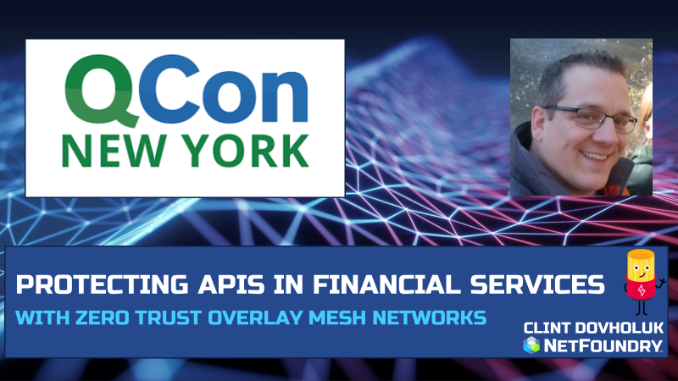
Jun 02, 2023
Episode Details
Securing APIs with OpenZiti and SPIRE! Application Embedded Zero Trust!

Slide 11
May 26, 2023
Episode Details
Office Hours and livestream

Slide 12


ZSSH with oidc!

Slide 13

Edgex Foundry + OpenZiti

Slide 14
Apr 28, 2023
Episode Details
Adding OpenZiti to microservice sample code

Slide 15


Apr 14, 2023
Episode Details
Even more zrok!!!
zrok in docker?
zrok in Kubernetes!?

Slide 16
Mar 31, 2023
Episode Details
OIDC, Keycloak, IdP, ext-jwt-signers

Slide 17
Mar 17, 2023
Episode Details
Working session: OpenZiti Network in Kubernetes!

Slide 18
Mar 10, 2023
Episode Details
Qcon 2023 Presentation

Slide 19


Mar 03, 2023
Episode Details
Monthly Forum

Slide 20
Feb 17, 2023
Episode Details
Release note read out
zrok in docker
zrok in Kubernetes!?

Slide 23


Slide 25
Feb 17, 2023
Episode Details
Release note read out
zrok in docker
zrok in Kubernetes!?

Slide 26

Feb 10, 2023
Episode Details
User Spotlight!

Slide 27
Feb 3, 2023
Episode Details
New container images!?

Slide 28
Jan 18, 2023
Episode Details
Javier Diaz from Jeju National University. Blockchain, OpenZiti and Intent-based networking

Slide 29
Dec 9, 2022
Episode Details
Release Notes:
0.21.11
Zitification – Beats!
SERPs

Slide 30
Jan 12, 2023
Episode Details
Monthly Ideas Forum

Slide 31
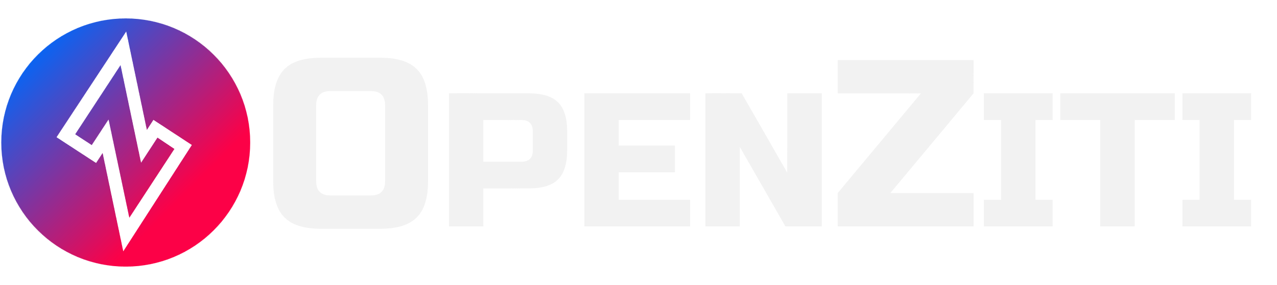

Nov 18, 2022
Episode Details
Release Notes:
0.26.11+
+

Slide 32
Nov 11, 2022
Episode Details
Release Notes:
0.26.11+
Looking at samples

Slide 33
Nov 04, 2022
Episode Details
Release Notes:
0.26.10+
BrowZer!!!

Slide 34
Oct 28, 2022
Episode Details
Release Notes:
0.26.10+
Working Session!

Slide 35
Oct 21, 2022
Episode Details
Release Notes:
0.26.10+
Config types – take 2!

Slide 36
Oct 07, 2022
Episode Details
Release Notes:
0.26.9+
Config types!

Slide 37
Sep 23, 2022
Episode Details
Release Notes:
0.26.8+
Linux UI/Packaging
Python SDK
Hacker News postings
other?

Slide 38
Sep 16, 2022
Release Notes:
0.26.5+
Multi-Region APIs with Kubernetes
Episode Details

Slide 39
Sep 09, 2022
Release Notes:
0.26.4+
VPN vs Zero Trust
User Experience
Episode Details

Slide 40
Sep 02, 2022
Release Notes:
0.26.4+
New ZDEW UI?
Episode Details

Slide 41
Aug 26, 2022
Release Notes:
0.26.4+
Custom PKI with OpenSSL?
Episode Details

Slide 42
Aug 12, 2022
Release Notes:
0.26.4+
CVE’s, Lambdas and OpenZiggy
Episode Details

Slide 43
Aug 05, 2022
Release Notes:
0.26.4+
ziti CLI and debugging
Episode Details

Slide 44
July 22, 2022
Release Notes:
0.26.2+
Application Embedded LDAP Client
Episode Details

Slide 45
July 15, 2022
Release Notes:
0.26.1+
Posture Checks
Episode Details

Slide 46
July 08, 2022
Release Notes:
0.26.1+
What is ‘zitify’?
Episode Details

Slide 47
July 01, 2022
Release Notes:
0.26.0+
Making ZAC and the Management API DARK!
Episode Details

Slide 48
June 17, 2022
Release Notes:
0.25.12+
Zitifying Ansible!?!?!
Episode Details

Slide 49
June 10, 2022
Release Notes:
0.25.11+
Python support and other SDK conversation
Episode Details

Slide 50
June 3, 2022
Release Notes:
None
Replacing SSH bastions with OpenZiti
Episode Details

Slide 51

June 3, 2022
Release Notes:
None
Replacing SSH bastions with OpenZiti
Episode Details

